Slide 1
Longitude and Latitude EQ – How do I find the distances on the earth’s surface?
Mrs James
Year 12 Essentials

Slide 2
24
7
30
Date
Longitude and Latitude
EQ – How do I find the distances on the earth’s surface?
How do I find the length of an arc?
7

Slide 3
24
7
30
Date
Longitude and Latitude
EQ – How do I find the distances on the earth’s surface?
7

Slide 4
24
7
30
Date
Longitude and Latitude
EQ – How do I find the distances on the earth’s surface?
7

Slide 6
Task
Distances on great circles time trial

Slide 7
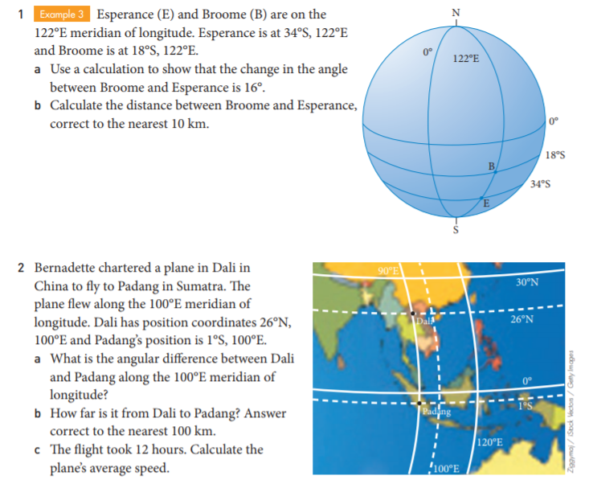
Finding distances between the earth’s surface practice questions

Slide 8
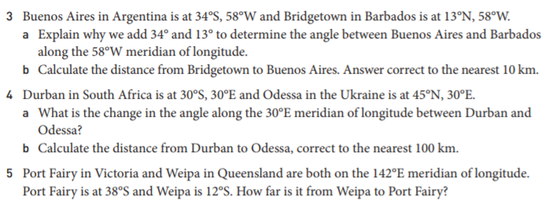

Slide 9
Notes Review
24, 7 ,30
Date
Title
Essential question
Notes complete
Notes complete with colour and diagrams
Questions completed
Contents page filed in
Formula page filled in

Slide 10
Homework
Review your notes and write a summary answering the essential question.

